Slide 1
WARNING
This collection of slides provides an idea of the course structure and key words.
It is NOT intended to substitute the readings required by the instructor.

Slide 2
TCHE321 CORPORATE FINANCE Nguyen Manh Hiep 2021

Slide 3
CHAPTER 1 INTRODUCTION

Slide 4
In this chapter:
I.
WHAT IS CORPORATE FINANCE?
II.
CORPORATE GOVERNANCE
III
HOMEWORK

Slide 5
GUIDE TO TCHE321
Go to the website. Download the reference guide, the slides. Supplementary materials are sent by email.
Ask questions in class or by email. Arrange rendezvous with the instructor if needed.
Mid-term 40%: daily oral tests, in-class performance, mid-term paper test(s). Final-term 60%: paper test.
Historical statistics: Grade A ~ 5%, B ~ 25%. C ~25%. D ~25%. F ~20%.

Slide 6
COURSE CONTENT
Chapter 1: Introduction
Chapter 2: Financial Statement Analysis
Chapter 3: Investment Appraisal
Chapter 4: Asset Pricing Models
Chapter 5: Capital Structure
Chapter 6: Dividend Policy
Chapter 7: Working Capital Management

Slide 7
I. WHAT IS CORPORATE FINANCE?
What is finance?
What is a corporation?

Slide 8
I. WHAT IS CORPORATE FINANCE?
The financial system
Public Finance
We focus on Corporate Finance (one major part of Business Finance)
Financial Markets
Financial Institutions
Business Finance
Personal Finance

Slide 9
I. WHAT IS CORPORATE FINANCE?
A business/A company/A firm is a group of natural or legal persons working together towards specific goals.
Types of Business Ownership
Proprietorship.
Partnership.
Corporation.
Are there other types of business organization?
What is a co-operative?
Can the owner of a sole proprietorship withdraw capital from the firm?
Can the owners of a corporation withdraw capital from the firm? Is it a good or a bad thing that they can/cannot withdraw their capital?
We focus on Corporations

Slide 10
I. WHAT IS CORPORATE FINANCE?
Discussion: Compare a proprietorship and a corporate in the following aspect:
Set-up cost.
Size.
Decision making process.
Risk to owner(s).
Income tax.
Labor cost.
…

Slide 11
I. WHAT IS CORPORATE FINANCE?
Some questions
In Vietnam, does a sole proprietorship pay enterprise income tax?
In a partnership, what is a general partner? What is a limited partner?
What is a public company? What is a private company?
What is a share of stock?
What is a corporate charter? bylaws?

Slide 12
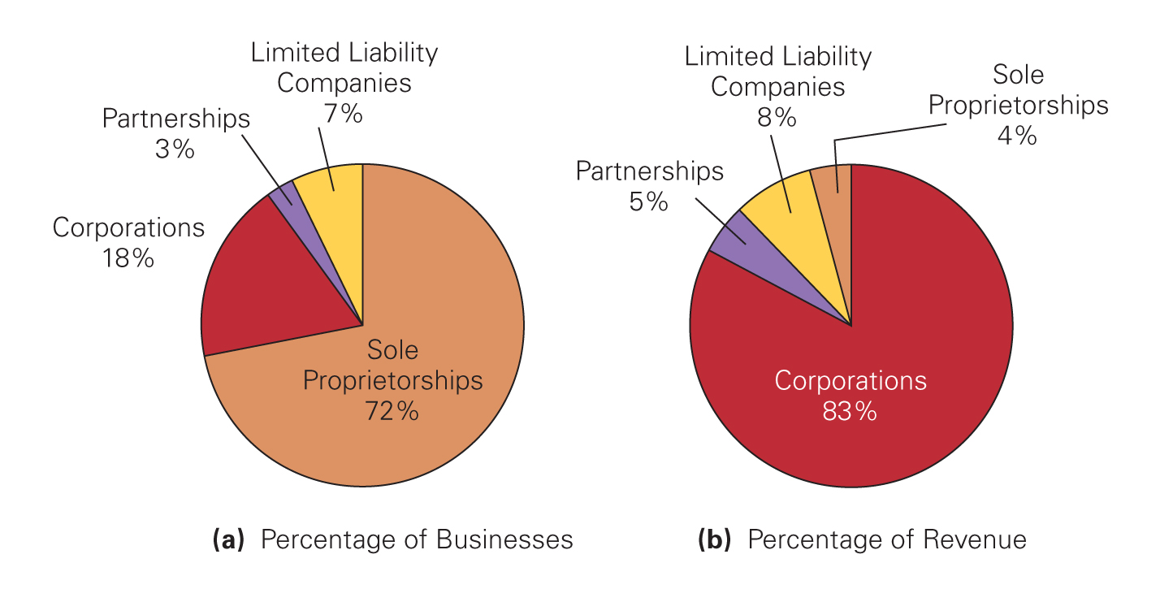
I. WHAT IS CORPORATE FINANCE?
Types of firms in the U.S.
Source: www.irs.gov; Berk, DeMarzo Corporate Finance 4th edition.

Slide 13
I. WHAT IS CORPORATE FINANCE?
Example X
Tuan Bach Limited has a debt of 100 bil. on the balance sheet payable in one year. Value of all asset is now 80 bil.
There is one investment opportunity available: Initial investment 50 bil. In one year, there is a probability of 30% that the return is 100 bil (win). and 70% that the return is 0 (fail).
Tuan Bach is the only owner and manager of the company.

Slide 14
I. WHAT IS CORPORATE FINANCE?
Example X (cont.)
If Tuan Bach decides not to invest. In one year, the value to Tuan Bach and debtholder will be:
a/ 80 bil and 20 bil b/ 100 bil and 0 bil
c/ Other
2. If Tuan Bach decides to invest and fail, in one year the value to Tuan Bach and debtholders will be:
a/ 100 bil and 0 bil b/ 80 bil and 20 bil
c/ 50 bil and 0 bil d/ Other

Slide 15
I. WHAT IS CORPORATE FINANCE?
Example X (cont.)
3. If Tuan Bach decides to invest and win. In one year, the value to Tuan Bach and debtholders will be:
a/ 100 bil and 0 bil b/ 80 bil and 20 bil
c/ 100 bil and 50 bil d/ Other
4. If you were Tuan Bach, what would you do?
a/ Invest b/ Do not invest
c/ Go America to hide from lenders

Slide 16
I. WHAT IS CORPORATE FINANCE?
Example Y
Tuan Bach Limited has a debt of 100 bil. on the balance sheet payable in one year. Value of all asset is now 40 bil.
There is one investment opportunity available: Initial investment 50 bil. In one year there is a probability of 70% that the return is 100 bil (win). and 30% that the return is 0 (fail).
Lenders refuse to lend. Tuan Bach can only raise capital through equity issue to himself, i.e., contributing more capital to the firm.

Slide 17
I. WHAT IS CORPORATE FINANCE?
Example Y (cont.)
1. If Tuan Bach decides to invest and fail, in one year the value to Nicolas shareholders and debtholders will be:
a/ 0 bil and 0 bil b/ 0 bil and 40 bil
c/ 0 bil and 50 bil d/ Other
2. If Tuan Bach decides to invest and win. In one year, the value to Nicolas shareholders and debtholders will be:
a/ 50 bil and 100 bil b/ 70 bil and 0 bil
c/ 0 bil and 70 bil d/ Other

Slide 18
I. WHAT IS CORPORATE FINANCE?
Example Y (cont.)
3. If you were Tuan Bach, what would you do?
a/ Contribute more capital to invest.
b/ Do not invest.
c/ Go America to hide from lenders.
d/ Other.

Slide 19
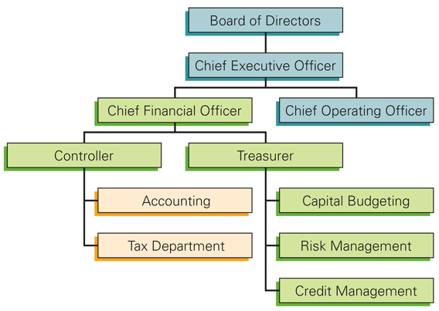
I. WHAT IS CORPORATE FINANCE?
Organizational Chart of a Corporation
Where are the shareholders in this chart?
Berk, DeMarzo Corporate Finance 4th edition.

Slide 20
I. WHAT IS CORPORATE FINANCE?
What Financial Officers do in a Corporation
Investment decisions
Financing decisions
Operating decisions
Which decision must be made first?
Example: What type of decision are these?
Tuan Bach Inc. buys from vendors on credit and requires cash payment immediately when selling to customers. Applies for a loan from a bank to build a plant. Pays dividends. Pays taxes.

Slide 21
I. WHAT IS CORPORATE FINANCE?
Example:
Sacom Investment and Development Corporation in 2011 buys VND31 billion worth of Quốc Cường Gia Lai shares.
Bibica Corporation from 2007 to 2010 reduces debt-to-assets from 0.45 to 0.28.

Slide 22
I. WHAT IS CORPORATE FINANCE?
The goal of financial decisions?
Maximizing shareholders’ value
Why? What about other stakeholders and the society? See more: Milton Friedman (1970): The Social Responsibility of Business Is to Increase Its Profits.
Do shareholders own the firm? Who decides where firm profit goes? Does the law require that the firm must act to achieve this goal? See Điều 165 Luật Doanh nghiệp 2020.
What is shareholders’ value?
Stock price
Jensen (2001), Value Maximization, Stakeholder Theory, and the Corporate Objective Function.
Does everyone agree? See more: Shareholders VS Stakeholders, A New Idolatry (The Economist), Unilever Warning on “Shareholder Value” (FT), Welch Condemns Share Price Focus (FT), Shareholder value: Investors must learn to respect long-term thinking (FT), We must rethink the purpose of the corporation (FT), Beyond the bottom line: should business put purpose before profit? (FT), Shareholders are being dethroned as rulers of value (FT).
Is the goal real and justified or flawed and unrealistic? See more: Lynn Stout (2012), The Shareholder Value Myth, How Putting Shareholders First Harms Investors, Corporations, and the Public, Berrett-Koehler Publishers.

Slide 23
II. CORPORATE GOVERNANCE
Principal-Agent Problem
Managers are agents of shareholders but act for their own self-interest.
That imposes a cost to shareholders (agency cost).
Are managers really agents of shareholders? Do they say they are? Do they believe they are? Do they act as if they are?

Slide 24
II. CORPORATE GOVERNANCE
Means to Mitigate Principal-Agent Problem
Ownership/Stock-based compensation.
Incentive pay.
Long-term contract.
Good corporate governance practice: a system of principles, policies, procedures and clearly defined responsibilities and accountabilities that helps to reduce the conflicts of interest.
What empirical studies say about their effectiveness?

Slide 25
II. CORPORATE GOVERNANCE
Example: Which of the following is often regarded as a sign of ineffective corporate governance system?
There is clear and measurable accountability for managers and directors in assuming their responsibilities.
Three-quarters of board members are independent.
CEO also serves as chairman of the board of directors.
Disclosure regarding operations and financial position are made with complete transparency and accuracy.
Internal audit committee consists only of independent directors who have expertise in financial and accounting matters.

Slide 26
II. CORPORATE GOVERNANCE
Example: Which of the following is least likely an approach the shareholders use to manage the principal-agent problem?
Participate in general meetings to discuss and vote on major corporate issues and transactions.
Elect and delegate a board of directors with oversight of the company.
Choose a prestigious independent auditor to audit the company’s annual financial records.
Regularly read and evaluate the company’s financial and non-financial information.
Build remuneration policies that align the interests of managers and directors with those of shareholders.
Vote for corporate social responsibility policies and practices that promote labor welfare, environmental protection, and social good.

Slide 27
II. CORPORATE GOVERNANCE
Divergence VS Concentration of Ownership
Mai Linh wants to expand her chain of fashion shop. She may borrow or sell 30% of her equity in the chain to raise fund.
If Mai Linh borrows fund (or sells equity ), $1 incremental income (or expense) from the shops will increase Mai Linh’s income by how much?
Predict Mai Linh’s behavior in each case.
See more: Berle and Means (1932)

Slide 28
II. CORPORATE GOVERNANCE
Management Entrenchment
Tuan Bach Corp. (100% equity) has 100 cash. Corporate tax rate 25%, personal tax rate 15%. Bank-deposit interest rate 5%. No investment opportunity is viable.
Should Tuấn Bách, CEO of Tuan Bach Corp, keep this amount of cash to deposit it on a bank account or should he pay out the money to shareholders (by devidend)?

Slide 29
II. CORPORATE GOVERNANCE
Short-term and long-term shareholders
Tuan Bach, CEO, is considering a long-term investment which requires a large capex, generates no revenue in the first two years and generates large revenue after the second year.
Phuong Xuan is a master student who will need to sell her shares next year to pay her tuition fee.
Dieu Le is an office employer who has a stable job and want to keep her shares until retirement.
In the annual meeting, Tuan Bach asks the shareholders to vote on the investment.

Slide 30
II. CORPORATE GOVERNANCE
Majority and minority shareholders
Tuan Bach owns 51% of shares in the company.
Mai Linh owns 29% and Mai Anh owns 20%.
Tuan Bach also owns NQ Inc, which is on the brink of bankruptcy and priced at VND100/share.
In the general meeting, Tuan Bach proposes an M&A plan to buy NQ at VND10000/share.
Predict if the M&A plan will be passed at the shareholders meeting.

Slide 31
II. CORPORATE GOVERNANCE
Socially (ir)responsible shareholders
In the annual meeting, Mai Linh, CEO of Papery Corp. proposes investing in a new technology of waste production which would cost the company a lot of money but will improve the company’s CSR profile.
Mai Linh also proposes that the company sells its stake in Marlbara Smoking Inc even though the investment generates very high dividend because she thinks that investing in cigarette is not socially responsible.

Slide 32
II. CORPORATE GOVERNANCE
Example: Which of the following cases most likely represent the conflicts of interest between the shareholders and the managers/directors?
In order to finance growth, managers and directors decide to increase borrowings to a level that would significantly increase default risk.
Managers and directors decide to abandon product safety features to reduce costs.
A controlling shareholder who owns a 51% stake in the company demand the managers and directors to buy inventory from his spouse’s company at above market price.
Managers and directors do not invest in high-risk projects even if they have positive NPV because they want to protect their employment status.
Managers and directors decide to use accounting practices that reduce the company’s tax expenses.

Slide 33
III. HOMEWORK
Management self-dealing
Find out what happened at Coteccons Construction Joint Stock Company (CTD). Do you think the management of this company is good or bad? Do you approve the actions of Kusto and Co.?

Slide 34
III. HOMEWORK
Short-termism and Staggered boards
Refer to Marginson2008, define short-termism and its causes.
Refer to Cremers2017, define a staggered board.
Is staggered boards a desired corporate governance practice? Explain using Cremers2017.

Slide 35
III. HOMEWORK
The Value of a Corrupt Manager (optional)
Tuan Bach is a corrupt CEO. He doesn’t abide to principles. He often finds ways to circumvent rules and regulations to achieve his goals, for example, by bribery, power abuse, bullying, unethical competition, etc.
Can Tuan Bach be good for a firm in any circumstance? Refer to Mironov2015 to answer this question.

Slide 36
III. HOMEWORK
CEO traits and governance (optional)
Refer to Cline2018, explain how managers’ indiscretion affect firm value.
Refer to Jia2014, explain how masculinity of CEO is related to financial misreporting.

Slide 37
III. HOMEWORK
Stakeholder Capitalism (optional)
Refer to the following link
Stakeholder capitalism, shareholder capitalism and state capitalism | World Economic Forum (weforum.org)
A Friedman doctrine‐- The Social Responsibility Of Business Is to Increase Its Profits - The New York Times (nytimes.com)
Refer to Webb2020 and Gual2020
Explain how stakeholder capitalism is different from shareholder capitalism.
Which idea do you prefer?

Slide 38
END OF CHAPTER 1

